Slide 1
Quaternions and 3D Rotation
Lukas Goodman

Slide 2
Agenda
Some Things Spinning
How Do We Rotate Things on Paper?
What About Off The Page?
Why Aren’t They Spinning Right?
Quaternions

Slide 3
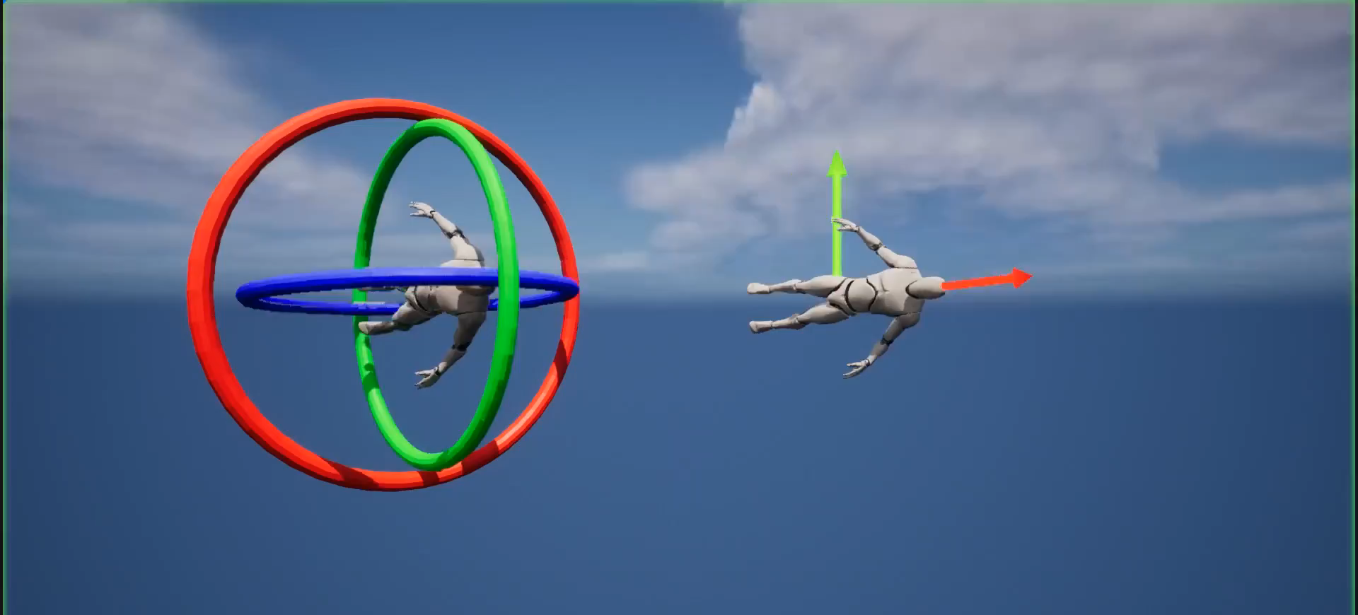

Slide 4
2-D Rotation

Slide 5


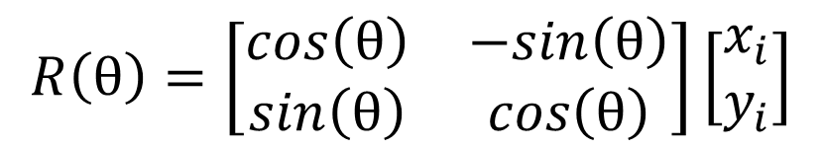
Matrices
$$x_{f}=x_{i}cos{θ}−y_{i}sin{θ}$$
$$R\left(θ\right)=\left[\begin{matrix}cos\left(θ\right) & −sin\left(θ\right) \\ sin\left(θ\right) & cos\left(θ\right)\end{matrix}\right]\left[\begin{matrix}x_{i} \\ y_{i}\end{matrix}\right]$$
$$y_{f}=x_{i}sin{θ}+y_{i}cos{θ}$$

Slide 6




Complex Numbers
$$\left(cos\left(θ\right)+i\sin\left(θ\right)\right)(x_{i}+iy_{i})$$
$$x_{f}=x_{i}cos{θ}−y_{i}sin{θ}$$
$$i=\sqrt{−1}$$
$$y_{f}=x_{i}sin{θ}+y_{i}cos{θ}$$

Slide 7




Resulting Equations
Matrices
Complex Numbers
$$x_{f}=x_{i}cos{θ}−y_{i}sin{θ}$$
$$x_{f}=x_{i}cos{θ}−y_{i}sin{θ}$$
$$y_{f}=x_{i}sin{θ}+y_{i}cos{θ}$$
$$y_{f}=x_{i}sin{θ}+y_{i}cos{θ}$$

Slide 8
3-D Rotation

Slide 9

Ways To Rotate in 3 Dimensions
Matrices
$R_{z}\left(γ\right)=\left[\begin{matrix}\cos{(γ)} & −\sin{(γ)} & 0 \\ \sin{(γ)} & \cos{(γ)} & 0 \\ 0 & 0 & 1\end{matrix}\right]$ $R_{y}\left(β\right)=\left[\begin{matrix}\cos{(β)} & 0 & \sin{(β)} \\ 0 & 1 & 0 \\ −\sin{(β)} & 0 & \cos{(β)}\end{matrix}\right]$
$$R_{x}\left(α\right)=\left[\begin{matrix}1 & 0 & 0 \\ 0 & \cos{(α)} & −\sin{(α)} \\ 0 & \sin{(α)} & \cos{(α)}\end{matrix}\right]$$

Slide 10
Ways To Rotate in 3 Dimensions
Matrices
$${{ R}_{x}\left(α\right){ R}_{y}\left(β\right)R}_{z}\left(γ\right)=\left[\begin{matrix}\cos\left(α\right)\cos\left(β\right) & −\sin\left(β\right) & \sin\left(α\right)\cos\left(β\right) \\ \cos\left(α\right)\sin\left(β\right)\cos\left(γ\right)+\sin\left(α\right)\sin\left(γ\right) & \cos\left(β\right)\cos\left(γ\right) & \sin\left(α\right)\sin\left(β\right)\cos\left(γ\right)−\cos\left(α\right)\sin\left(γ\right) \\ \cos\left(α\right)\sin\left(β\right)\sin\left(γ\right)+\sin\left(α\right)\cos\left(γ\right) & \cos\left(β\right)\sin\left(γ\right) & \sin\left(α\right)\sin\left(β\right)\sin\left(γ\right)−\cos\left(α\right)\cos\left(β\right)\end{matrix} \right]$$

Slide 11
Resulting Equations
Matrices
$$x_{f}=x_{i}cos\left(α\right)cos⁡\left(β\right)−y_{i}sin\left(β\right)+z_{i}\sin\left(α\right)cos⁡\left(β\right)$$
$$y_{f}=x_{i}\left(\cos\left(α\right)\sin\left(β\right)\cos\left(γ\right)+\sin\left(α\right)\sin\left(γ\right)\right)+y_{i}\left(\cos\left(β\right)\cos\left(γ\right)\right)+z_{i}(\sin\left(α\right)\sin\left(β\right)cos\left(γ\right)−\cos\left(α\right)sin\left(γ\right))$$
$$z_{f}=x_{i}\left(\cos\left(α\right)\sin\left(β\right)\cos\left(γ\right)+\sin\left(α\right)\sin\left(γ\right)\right)+y_{i}\left(\cos\left(β\right)\cos\left(γ\right)\right)+z_{i}(\sin\left(α\right)\sin\left(β\right)cos\left(γ\right)−\cos\left(α\right)sin\left(γ\right))$$

Slide 12
Why Aren’t They Spinning Right?

Slide 13

Rotation Matrices
Matrices
$R_{z}\left(γ\right)=\left[\begin{matrix}\cos{(γ)} & −\sin{(γ)} & 0 \\ \sin{(γ)} & \cos{(γ)} & 0 \\ 0 & 0 & 1\end{matrix}\right]$ $R_{y}\left(β\right)=\left[\begin{matrix}\cos{(β)} & 0 & \sin{(β)} \\ 0 & 1 & 0 \\ −\sin{(β)} & 0 & \cos{(β)}\end{matrix}\right]$
$$R_{x}\left(α\right)=\left[\begin{matrix}1 & 0 & 0 \\ 0 & \cos{(α)} & −\sin{(α)} \\ 0 & \sin{(α)} & \cos{(α)}\end{matrix}\right]$$

Slide 14
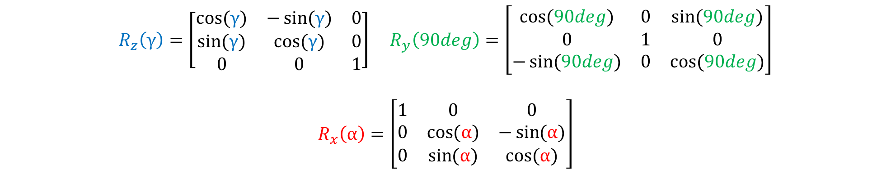
Matrix Composition
Matrices
$R_{z}\left(γ\right)=\left[\begin{matrix}\cos{(γ)} & −\sin{(γ)} & 0 \\ \sin{(γ)} & \cos{(γ)} & 0 \\ 0 & 0 & 1\end{matrix}\right]$ $R_{y}\left(90deg\right)=\left[\begin{matrix}\cos{(90deg)} & 0 & \sin{(90deg)} \\ 0 & 1 & 0 \\ −\sin{(90deg)} & 0 & \cos{(90deg)}\end{matrix}\right]$
$$R_{x}\left(α\right)=\left[\begin{matrix}1 & 0 & 0 \\ 0 & \cos{(α)} & −\sin{(α)} \\ 0 & \sin{(α)} & \cos{(α)}\end{matrix}\right]$$

Slide 15
Here’s The Problem
Matrices
$$R_{z}\left(γ\right){ R}_{y}\left(β\right){ R}_{x}\left(α\right)=\left[\begin{matrix}0 & 0 & 1 \\ sin⁡(α+γ) & cos⁡(α+γ) & 0 \\ −cos⁡(α+γ) & sin⁡(α+γ) & 0\end{matrix} \right]$$

Slide 16
Ways To Rotate in 3 Dimensions
Matrices
$$R_{z}\left(γ\right){ R}_{y}\left(β\right){ R}_{x}\left(α\right)=\left[\begin{matrix}\cos\left(α\right)\cos\left(β\right) & −\sin\left(β\right) & \sin\left(α\right)\cos\left(β\right) \\ \cos\left(α\right)\sin\left(β\right)\cos\left(γ\right)+\sin\left(α\right)\sin\left(γ\right) & \cos\left(β\right)\cos\left(γ\right) & \sin\left(α\right)\sin\left(β\right)\cos\left(γ\right)−\cos\left(α\right)\sin\left(γ\right) \\ \cos\left(α\right)\sin\left(β\right)\sin\left(γ\right)+\sin\left(α\right)\cos\left(γ\right) & \cos\left(β\right)\sin\left(γ\right) & \sin\left(α\right)\sin\left(β\right)\sin\left(γ\right)−\cos\left(α\right)\cos\left(β\right)\end{matrix} \right]$$

Slide 17
It All Comes Down To This
Matrices
$$R_{z}\left(γ\right){ R}_{y}\left(β\right){ R}_{x}\left(α\right)=\left[\begin{matrix}0 & 0 & 1 \\ sin⁡(α+γ) & cos⁡(α+γ) & 0 \\ −cos⁡(α+γ) & sin⁡(α+γ) & 0\end{matrix} \right]$$

Slide 18
Quaternions

Slide 19

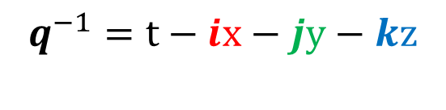

What is a Quaternion?
Complex Numbers: Quaternions
$$i,j,k=\sqrt{−1}$$
$q=t+ix+jy+kz$
$q^{−1}=t−ix−jy−kz$

Slide 20
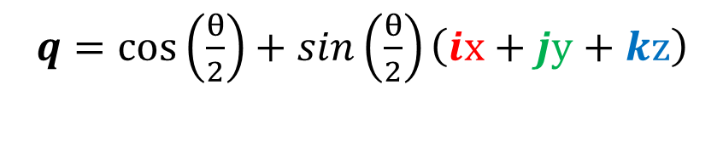
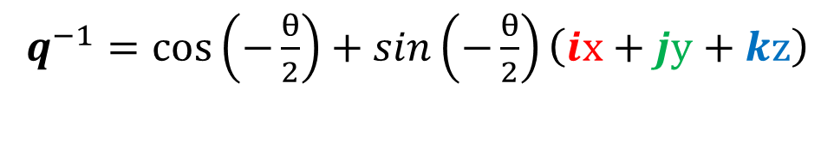
Polar Definition
Complex Numbers: Quaternions
$q=cos\left(\frac{θ}{2}\right)+sin\left(\frac{θ}{2}\right)\left(ix+jy+kz\right)$
$q^{−1}=cos\left(−\frac{θ}{2}\right)+sin\left(−\frac{θ}{2}\right)\left(ix+jy+kz\right)$

Slide 21
Complex Numbers
$$\left(cos\left(θ\right)+i\sin\left(θ\right)\right)(x_{i}+iy_{i})$$
$$x_{f}=x_{i}cos{θ}−y_{i}sin{θ}$$
$$i=\sqrt{−1}$$
$$y_{f}=x_{i}sin{θ}+y_{i}cos{θ}$$

Slide 22
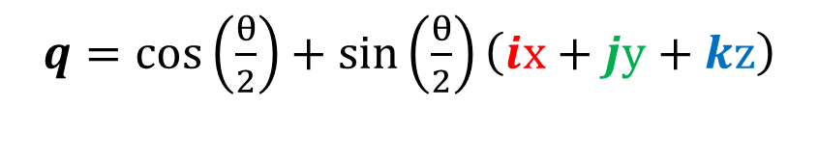
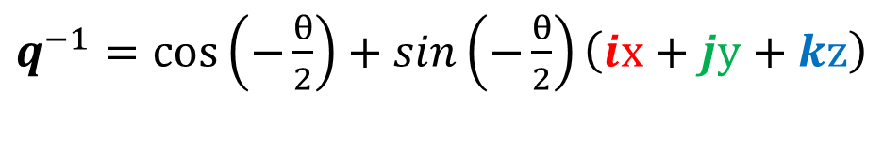
Polar Definition
Complex Numbers: Quaternions
$q=cos\left(\frac{θ}{2}\right)+\sin\left(\frac{θ}{2}\right)\left(ix+jy+kz\right)$
$q^{−1}=cos\left(−\frac{θ}{2}\right)+sin\left(−\frac{θ}{2}\right)\left(ix+jy+kz\right)$

Slide 23



Rotation
Complex Numbers: Quaternions
$u=ix+jy+kz$
$p=ix_{p}+jy_{p}+kz_{p}$
$Rq=qpq^{−1}$
$Rq=$ $\left(cos\left(\frac{θ}{2}\right)+sin\left(\frac{θ}{2}\right)u\right) \left(p\right)\left(cos\left(−\frac{θ}{2}\right)+sin\left(−\frac{θ}{2}\right)u\right)$

Slide 24
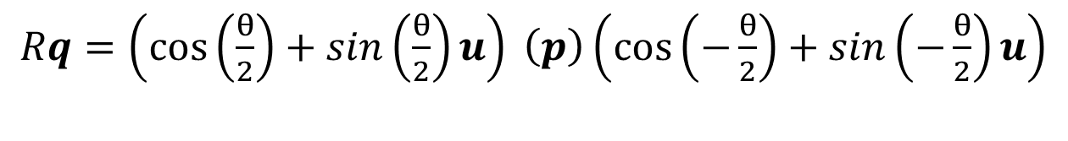
Rotation
Complex Numbers: Quaternions
$Rq=\left(cos\left(\frac{θ}{2}\right)+sin\left(\frac{θ}{2}\right)u\right) \left(p\right)\left(cos\left(−\frac{θ}{2}\right)+sin\left(−\frac{θ}{2}\right)u\right)$
$$Rq=p\left(\cos\left(θ\right)\right)+\left(u×p\right)\left(sin\left(θ\right)\right)+\left(u∙p\right)u− \left(u∙p\right)u\left(\cos\left(θ\right)\right)$$

Slide 25
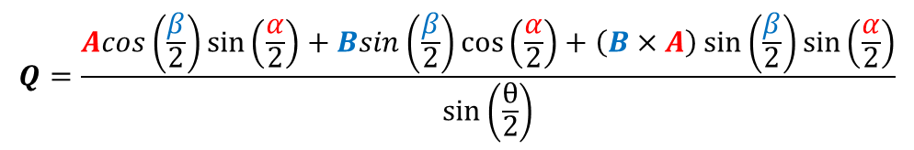

Ways To Rotate in 3 Dimensions
Complex Numbers: Quaternions
$$R_{a}R_{b}=R_{Q}=\cos\left(\frac{θ}{2}\right)+Q\sin\left(\frac{θ}{2}\right)$$
θ $=2\cos^{−1}\left(\cos\left(\frac{β}{2}\right)\cos\left(\frac{α}{2}\right)−\left(B∙A\right)\sin\left(\frac{β}{2}\right)\sin\left(\frac{α}{2}\right)\right)$
$$Q=\frac{Acos\left(\frac{β}{2}\right)\sin\left(\frac{α}{2}\right)+Bsin\left(\frac{β}{2}\right)\cos\left(\frac{α}{2}\right)+\left(B×A\right)\sin\left(\frac{β}{2}\right)\sin\left(\frac{α}{2}\right)}{\sin\left(\frac{θ}{2}\right)}$$

Slide 26
How Do We Use Them?

Slide 27
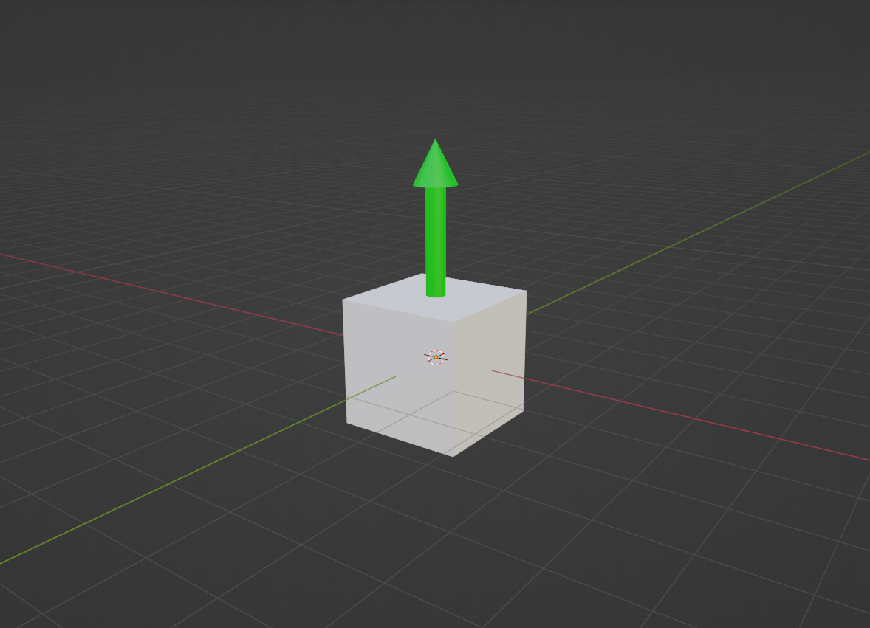

Rotation
$q=cos(0)+sin\left(0\right)\left(0i+0j+1z\right)$

Slide 28
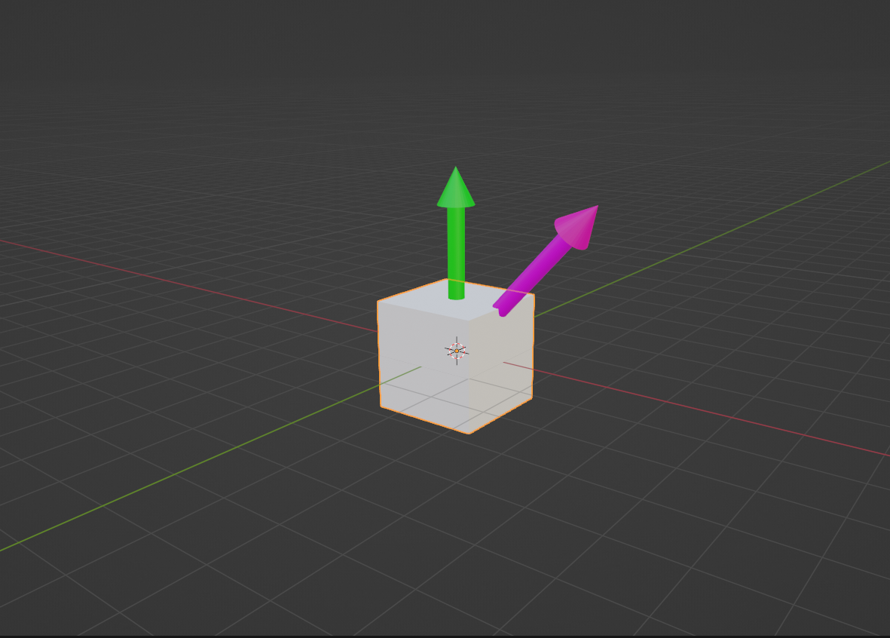

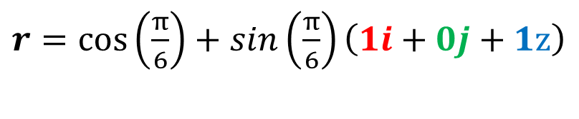
Rotation
$q=cos(0)+sin\left(0\right)\left(0i+0j+1z\right)$
$r=cos\left(\frac{π}{6}\right)+sin\left(\frac{π}{6}\right)\left(1i+0j+1z\right)$

Slide 29
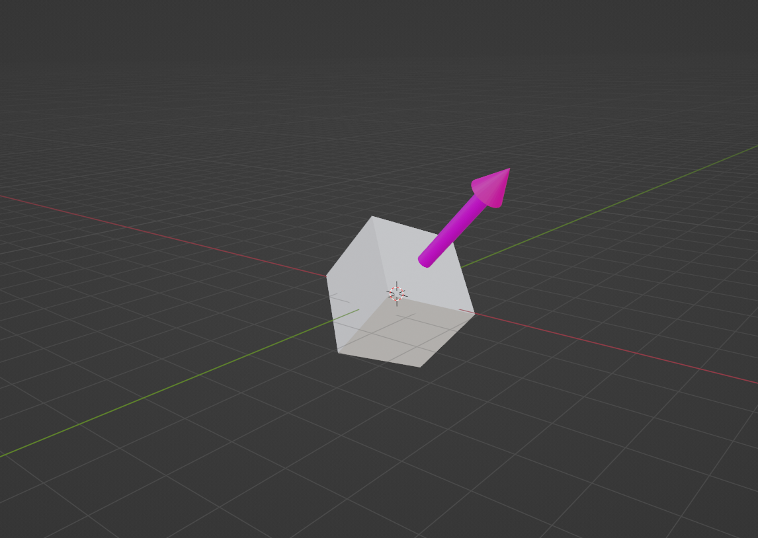

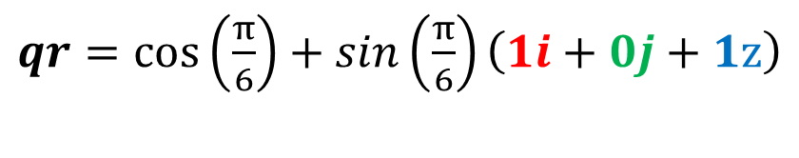

Rotation
$q=cos(0)+sin\left(0\right)\left(0i+0j+1z\right)$
$r=cos\left(\frac{π}{6}\right)+sin\left(\frac{π}{6}\right)\left(1i+0j+1z\right)$
$qr=cos\left(\frac{π}{6}\right)+sin\left(\frac{π}{6}\right)\left(1i+0j+1z\right)$

Slide 31
Thank you
Lukas Goodman

